Slide 1
<Python>
<Kiana kholousi>

Slide 2
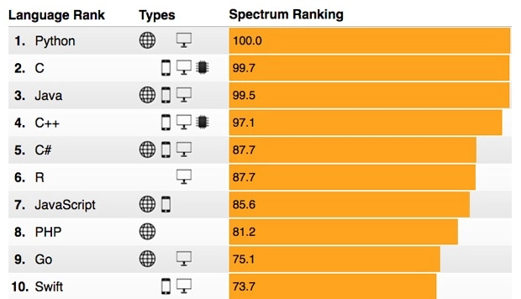




TOP programming languages by IEEE (Institute of Electrical and Electronics Engineers)
Website and applications
Mobile application development
Enterprise desktop and scientific application
Embedded(languages use to program device controllers)

Slide 3
Brief History of Python
Invented in the Netherlands, early 90s by Guido van Rossum
Named after Monty Python
Python 2 release on 16 October 2000
Python 3 in 2008
We will use python 3 latest release 3.10.0 in 2021

Slide 4
Why python
Versatility(AI and Machine Learning, Data Analytics (Data Science, Data Mining), Data Visualization, Web Development, App Development, Game Development, Finance, Design, Network and Security)
high-level
Short and simple syntax
Free and open-source
Expandable and Adaptable
OOP
scripting language

Slide 5
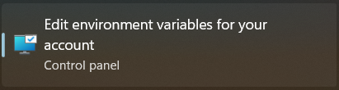
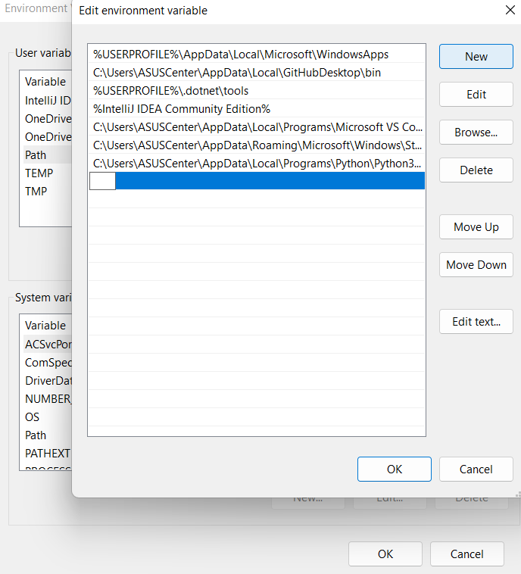
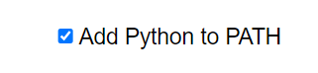
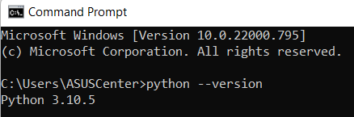
INSTALLATION
1
Install the latest version of python from
https://www.python.org/downloads/
Vs code:
https://code.visualstudio.com/download
https://soft98.ir/software/programming/53-visual-studio-code-1.html
3
2
Installation address
4

Slide 6
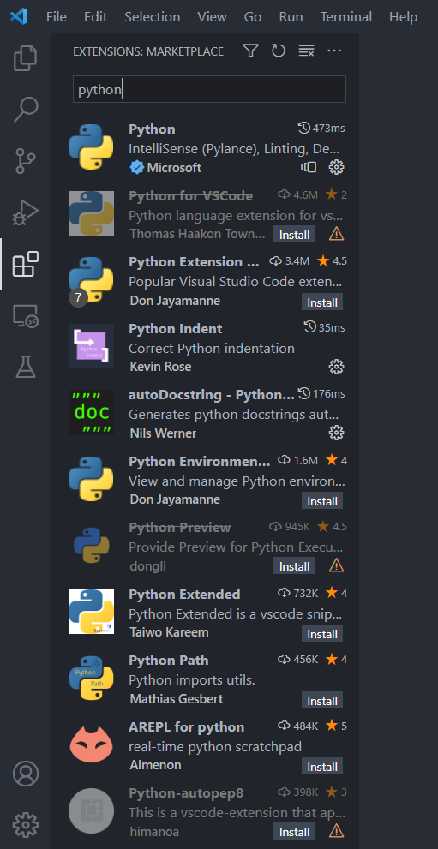
Vs code IDE
Helpful Extensions:
Python Indent
Better comments
Python Docstring Generator
Python Type Hint
Python Preview
Python Snippets

Slide 7
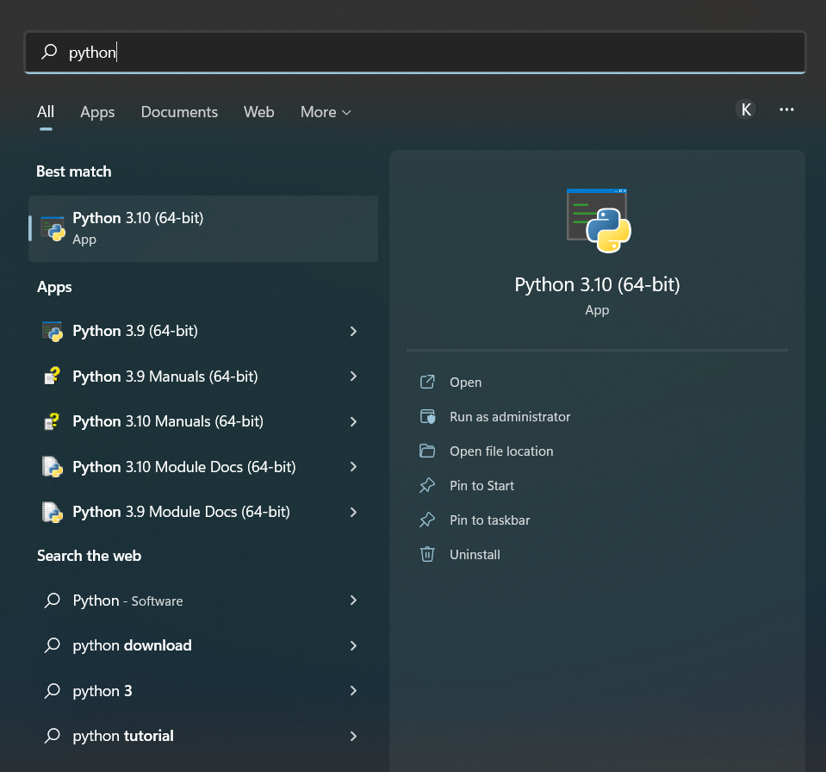
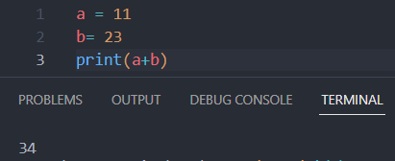
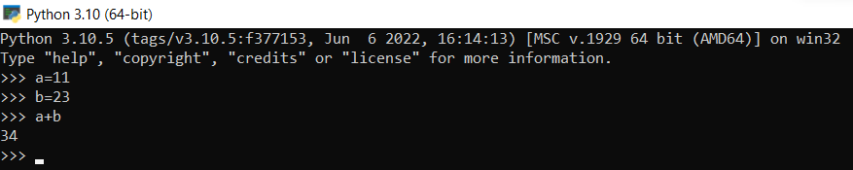
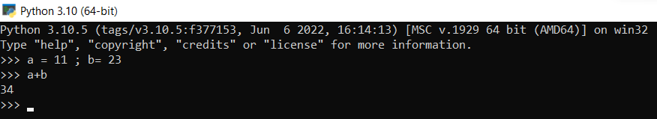
interactive use
1
2
- Use “;” when you want to run multiple commands in a single line

Slide 8
Python Syntax compared to other programming languages
Python was designed for readability and has some similarities to the English language with influence from mathematics.
Python uses new lines to complete a command, as opposed to other programming languages which often use semicolons or parentheses.
Python relies on indentation, using whitespace, to define scope; such as the scope of loops, functions and classes. Other programming languages often use curly-brackets for this purpose.

Slide 9

Data Type
Numeric Types: int, float, complex
Sequence Types: String, list, tuple
Mapping Type: dictionary
Set Types: set, frozenset
Boolean Type: bool
None Type: None Type

Slide 10
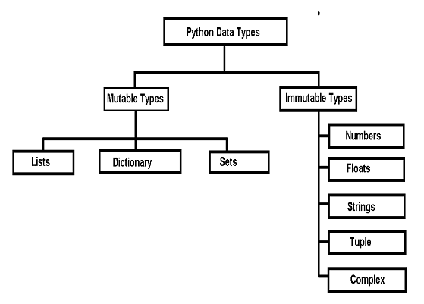
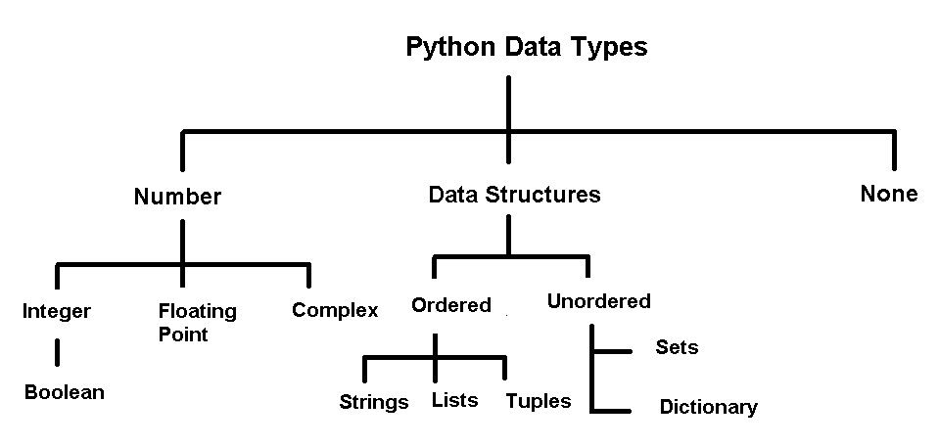
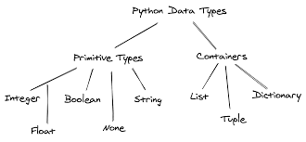
Different sorting method for data types

Slide 11
Variables
Variables are used to store data; they take memory space based on the type of value we assigning to them.
A variable is created the moment you first assign a value to it
Variables do not need to be declared with any particular type and can even change type after they have been set.
Case sensitive
To Get the type of a variable use type(variableName)
casting

Slide 12
Variable names
A variable name can only contain alpha-numeric characters and underscores (A-z, 0-9, and _ )
A variable name must start with a letter or the underscore character(A variable name cannot start with a number)
Variable names are case-sensitive (age, Age and AGE are three different variables)
Multi Words Variable Names:
Variable names with more than one word can be difficult to read.
Camel Case: Each word, except the first, starts with a capital letter: myVariableName
Pascal Case: Each word starts with a capital letter: MyVariableName
Snake Case: Each word is separated by an underscore character my_variable_name

Slide 13
Python keywords
Keyword | Description
and | A logical operator
as | To create an alias
assert | For debugging
break | To break out of a loop
class | To define a class
continue | To continue to the next iteration of a loop
def | To define a function
del | To delete an object
elif | Used in conditional statements, same as else if
else | Used in conditional statements
except | Used with exceptions, what to do when an exception occurs
False | Boolean value, result of comparison operations
finally | Used with exceptions, a block of code that will be executed no matter if there is an exception or not
for | To create a for loop
from | To import specific parts of a module
global | To declare a global variable
if | To make a conditional statement
import | To import a module
in | To check if a value is present in a list, tuple, etc.
is | To test if two variables are equal
lambda | To create an anonymous function
None | Represents a null value
nonlocal | To declare a non-local variable
not | A logical operator
or | A logical operator
pass | A null statement, a statement that will do nothing
raise | To raise an exception
return | To exit a function and return a value
True | Boolean value, result of comparison operations
try | To make a try...except statement
while | To create a while loop
with | Used to simplify exception handling
yield | To end a function, returns a generator

Slide 14
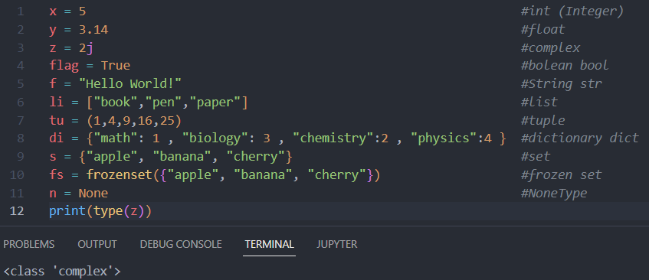
-In python you don’t need to specify the data type when declare a variable
-to get the type of an object use the type() function

Slide 15
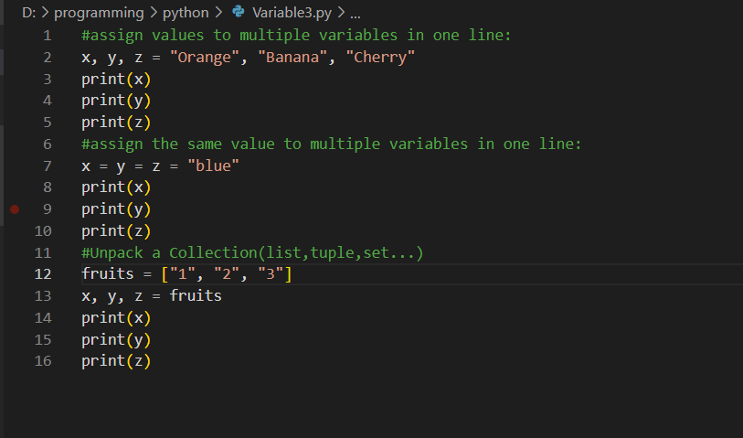
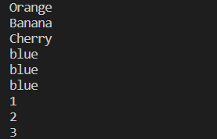
Assign Multiple Values
Output:

Slide 16
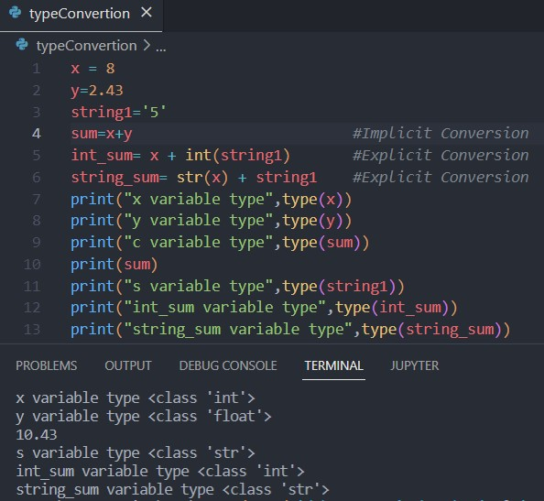
Type Casting(Implicit Conversion)
Done automatically by the Python interpreter.

Slide 17
Type Casting(Explicit Conversion)
Needs to be done manually by the programmer.
int() - constructs an integer number from an integer literal, a float literal (by removing all decimals), or a string literal (providing the string represents a whole number)
float() - constructs a float number from an integer literal, a float literal or a string literal (providing the string represents a float or an integer)
str() - constructs a string from a wide variety of data types, including strings, integer literals and float literals

Slide 18
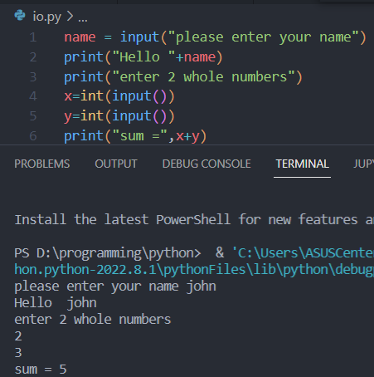
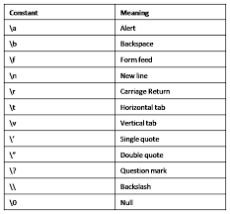
Output & input
Print special characters:
Print()
Input() => str
-int(input()) => int
-float(input()) => float
To Display a comment while getting input
Input(“comment”)

Slide 19
String
Strings in python are surrounded by either single quotation marks, or double quotation marks.
“hello” is the same as ‘hello’
Strings like Arrays support indexing(index starts from 0)
Length of a Sting can be accessed by Len(StringName)
Last index of string SringName[-1] or StringName[len(StringName)-1]
Advance for loop for iteration
In keyword to check for substrings

Slide 20
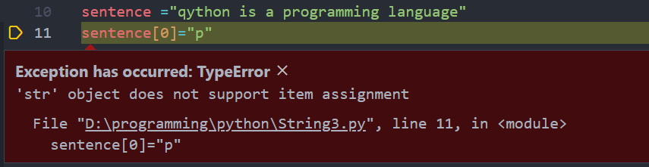
IMMUTABLE
StringName = “StringValue” #assignment
Object: String item: character
- You can't change an existing string, but you can create new one

Slide 21
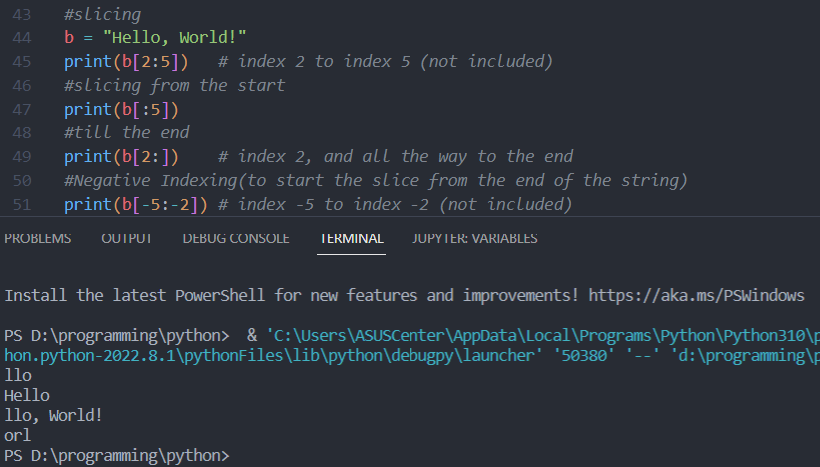
Slicing
Specify the start index and the end index, separated by a colon, to return a part of the string.

Slide 22
String methods
Method | Description
capitalize() | Converts the first character to upper case
casefold() | Converts string into lower case
center() | Returns a centered string
count() | Returns the number of times a specified value occurs in a string
encode() | Returns an encoded version of the string
endswith() | Returns true if the string ends with the specified value
expandtabs() | Sets the tab size of the string
find() | Searches the string for a specified value and returns the position of where it was found
format() | Formats specified values in a string
format_map() | Formats specified values in a string
index() | Searches the string for a specified value and returns the position of where it was found
isalnum() | Returns True if all characters in the string are alphanumeric
isalpha() | Returns True if all characters in the string are in the alphabet
isdecimal() | Returns True if all characters in the string are decimals
isdigit() | Returns True if all characters in the string are digits
isidentifier() | Returns True if the string is an identifier
islower() | Returns True if all characters in the string are lower case
isnumeric() | Returns True if all characters in the string are numeric
isprintable() | Returns True if all characters in the string are printable
isspace() | Returns True if all characters in the string are whitespaces
istitle() | Returns True if the string follows the rules of a title

Slide 23
isupper() | Returns True if all characters in the string are upper case
join() | Joins the elements of an iterable to the end of the string
ljust() | Returns a left justified version of the string
lower() | Converts a string into lower case
lstrip() | Returns a left trim version of the string
maketrans() | Returns a translation table to be used in translations
partition() | Returns a tuple where the string is parted into three parts
replace() | Returns a string where a specified value is replaced with a specified value
rfind() | Searches the string for a specified value and returns the last position of where it was found
rindex() | Searches the string for a specified value and returns the last position of where it was found
rjust() | Returns a right justified version of the string
rpartition() | Returns a tuple where the string is parted into three parts
rsplit() | Splits the string at the specified separator, and returns a list
rstrip() | Returns a right trim version of the string
split() | Splits the string at the specified separator, and returns a list
splitlines() | Splits the string at line breaks and returns a list
startswith() | Returns true if the string starts with the specified value
strip() | Returns a trimmed version of the string
swapcase() | Swaps cases, lower case becomes upper case and vice versa
title() | Converts the first character of each word to upper case
translate() | Returns a translated string
upper() | Converts a string into upper case
zfill() | Fills the string with a specified number of 0 values at the beginning

Slide 24
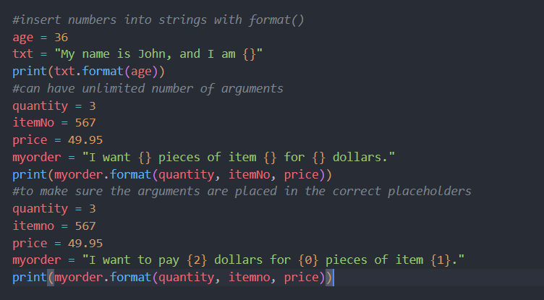
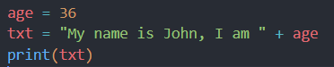
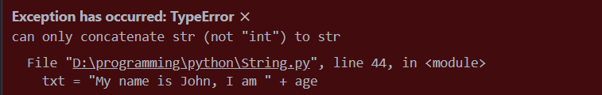
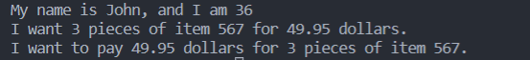
String Format
Instead, we use String.format():
We can't combine strings & numbers like this:
Output:

Slide 25
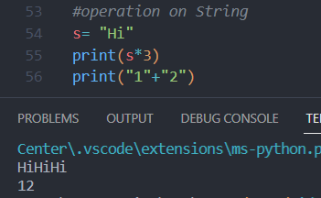
String Operation

Slide 26
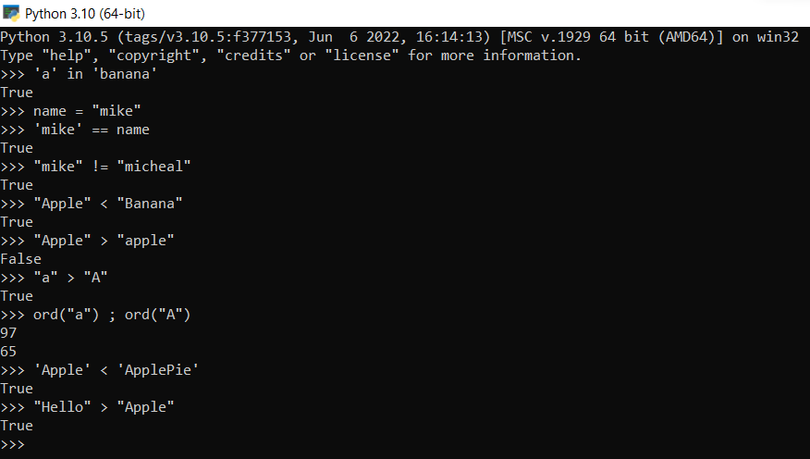
String Comparison
The characters in both strings are compared one by one(Unicode value is compared).

Slide 27
Operation type
Arithmetic operators
Assignment operators
Comparison operators
Logical operators
Identity operators
Membership operators
Bitwise operators

Slide 28
Arithmetic Operators
Operator | Name | Example
+ | Addition | x + y
- | Subtraction | x - y
* | Multiplication | x * y
/ | Division | x / y
% | Modulus | x % y
** | Exponentiation | x ** y
// | Floor division | x // y
-Python doesn’t support ++i / i++

Slide 29
Order of operations
Python follows the mathematic convention. (PEMDAS)
Parentheses
Exponentiation
Multiplication and Division
Addition and Subtraction
-operators with the same precedence are evaluated from left to right

Slide 30
Assignment Operators
Operator | Example | Same As
= | x = 5 | x = 5
+= | x += 3 | x = x + 3
-= | x -= 3 | x = x - 3
*= | x *= 3 | x = x * 3
/= | x /= 3 | x = x / 3
%= | x %= 3 | x = x % 3
//= | x //= 3 | x = x // 3
**= | x **= 3 | x = x ** 3
&= | x &= 3 | x = x & 3
|= | x |= 3 | x = x | 3
^= | x ^= 3 | x = x ^ 3
>>= | x >>= 3 | x = x >> 3
<<= | x <<= 3 | x = x << 3
In-place operator

Slide 31
Comparison Operators
Operator | Name | Example
== | Equal | x == y
!= | Not equal | x != y
> | Greater than | x > y
< | Less than | x < y
>= | Greater than or equal to | x >= y
<= | Less than or equal to | x <= y

Slide 32
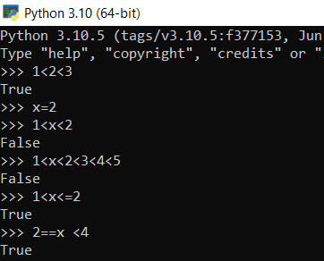
Chaining Comparison Operators
x<y<z is similar to x<y and y<z

Slide 33
Logical Operators
Operator | Description | Example
and | Returns True if both statements are true | x < 5 and x < 10
or | Returns True if one of the statements is true | x < 5 or x < 4
not | Reverse the result, returns False if the result is true | not(x < 5 and x < 10)

Slide 34
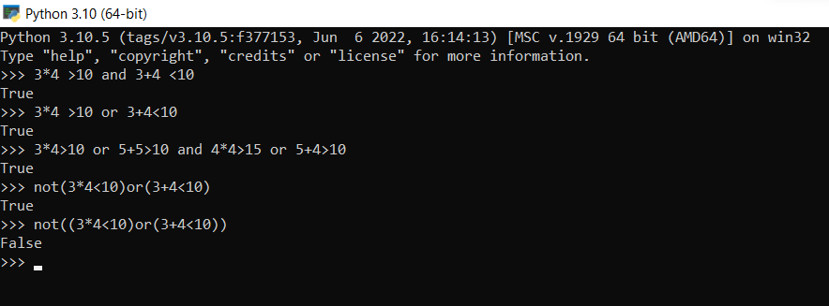
Logical Comparison Example

Slide 35
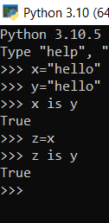
Identity Operators
Operator | Description | Example
is | Returns True if both variables are the same object | x is y
is not | Returns True if both variables are not the same object | x is not y
Membership Operators
Operator | Description | Example
in | Returns True if a sequence with the specified value is present in the object | x in y
not in | Returns True if a sequence with the specified value is not present in the object | x not in y

Slide 36
Bitwise Operators
Operator | Name | Description
& | AND | Sets each bit to 1 if both bits are 1
| | OR | Sets each bit to 1 if one of two bits is 1
^ | XOR | Sets each bit to 1 if only one of two bits is 1
~ | NOT | Inverts all the bits
<< | Zero fill left shift | Shift left by pushing zeros in from the right and let the leftmost bits fall off
>> | Signed right shift | Shift right by pushing copies of the leftmost bit in from the left, and let the rightmost bits fall off

Slide 37
comment
# (octothorpe)
A comment can be text that explains the code, it can also be used to prevent Python from executing code

Slide 38
Conditional statements
If condition:
statement
elif condition:
statement
else:
statement
-you can only have 1 else for every if, but you can have any number of(unlimited) if and elif(else if)
-pay attention to the indentation
-the code in elif will execute when the condition in if is false and condition in elif is ture

Slide 39
if condition:
Statement
if condition:
Statement
else condition:
Statement
condition
yes
statement
One Way Decision
statement
statement
no
condition
yes
statement
statement
Two Way Decision
statement
statement
statement
statement

Slide 40
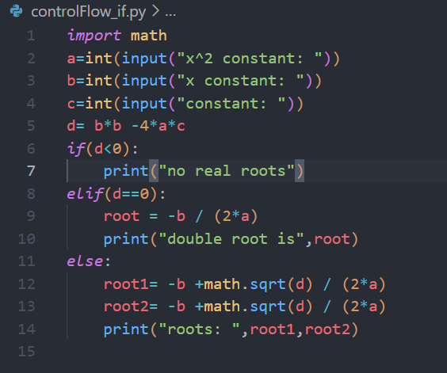
Multi-way Decision
If condition:
statement
elif condition:
statement
…
else:
statement

Slide 41
Decision Tree
No
x1>x2
Yes
No
x2>x3
Yes
No
x1>x3
Yes
Max=x3
Max=x2
Max=x3
Max=x1

Slide 42
PAss
Pass statement is used as a place holder when empty code is not allowed(loops, function and class definition and if statement)
When pass statement executes nothing happens

Slide 43
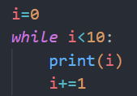
Control flow: While
while condition:
Body(statement)
-indefinite loop
-python doesn’t have do while

Slide 44
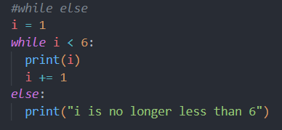
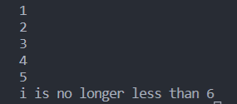
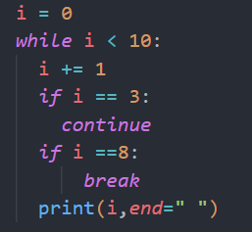
while
-the block inside else will run when the condition is no longer met
Break & continue
use break to exit the loop
use continue to skip index/iteration
Output:
Output:

Slide 45
Control flow: for
For VariableName in Sequence:
Body(statement)
For is used to write definite loops in python (number of iteration is determined before the start of the loop)
-VariableName is the loops index
-Sequence is list of values(string, list,…)
-range(n)

Slide 46
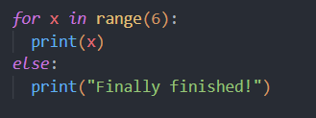
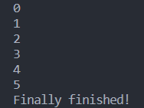
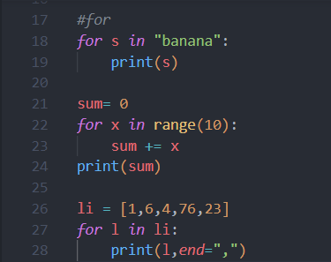
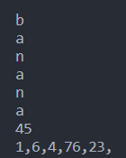
for
else
Iteration
Output:
-else block executes when loop finishes NOT if the loop is stopped by a break statement

Slide 47
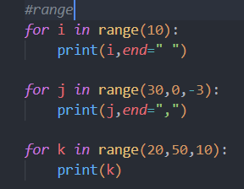
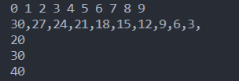
range
range(start, end, step)
-doesn’t include the end
-if start not specified starts from 0
-If step not specified increments by 1
Output:

Slide 48
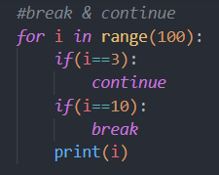
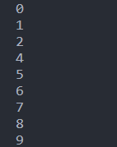
Continue & break
-use break to end a loop
-use continue to stop the current iteration and go to the next one
Output:

Slide 49
Examples
Sum/Average of a series of numbers
Odd/even sequence
Fibonacci sequence
Rectangle of stars

Slide 50
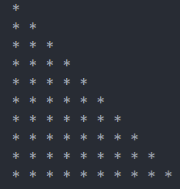
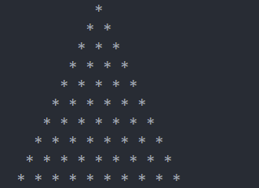
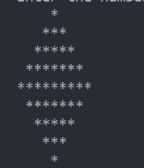
Nested for
Star pattern examples

Slide 51
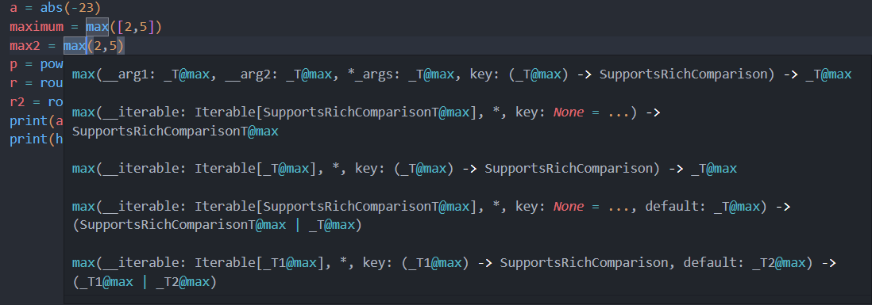
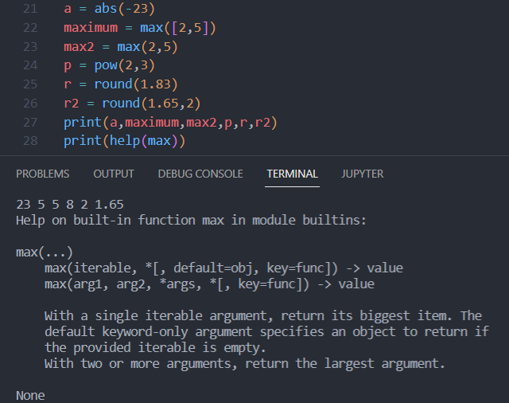
functions
Reusable code
Solves particular task
Call function instead of writing code yourself
type(), max(), min(), print(),…
Output = function_name(input)

Slide 52
Python built-in functions
Function | Description
abs() | Returns the absolute value of a number
all() | Returns True if all items in an iterable object are true
any() | Returns True if any item in an iterable object is true
ascii() | Returns a readable version of an object. Replaces none-ascii characters with escape character
bin() | Returns the binary version of a number
bool() | Returns the boolean value of the specified object
bytearray() | Returns an array of bytes
bytes() | Returns a bytes object
callable() | Returns True if the specified object is callable, otherwise False
chr() | Returns a character from the specified Unicode code.
classmethod() | Converts a method into a class method
compile() | Returns the specified source as an object, ready to be executed
complex() | Returns a complex number
delattr() | Deletes the specified attribute (property or method) from the specified object
dict() | Returns a dictionary (Array)
dir() | Returns a list of the specified object's properties and methods
divmod() | Returns the quotient and the remainder when argument1 is divided by argument2
enumerate() | Takes a collection (e.g. a tuple) and returns it as an enumerate object

Slide 53
eval() | Evaluates and executes an expression
exec() | Executes the specified code (or object)
filter() | Use a filter function to exclude items in an iterable object
float() | Returns a floating point number
format() | Formats a specified value
frozenset() | Returns a frozenset object
getattr() | Returns the value of the specified attribute (property or method)
globals() | Returns the current global symbol table as a dictionary
isinstance() | Returns True if a specified object is an instance of a specified object
issubclass() | Returns True if a specified class is a subclass of a specified object
iter() | Returns an iterator object
len() | Returns the length of an object
list() | Returns a list
locals() | Returns an updated dictionary of the current local symbol table
map() | Returns the specified iterator with the specified function applied to each item
max() | Returns the largest item in an iterable
memoryview() | Returns a memory view object
min() | Returns the smallest item in an iterable
next() | Returns the next item in an iterable
object() | Returns a new object
oct() | Converts a number into an octal
open() | Opens a file and returns a file object
ord() | Convert an integer representing the Unicode of the specified character
pow() | Returns the value of x to the power of y

Slide 54
print() | Prints to the standard output device
property() | Gets, sets, deletes a property
range() | Returns a sequence of numbers, starting from 0 and increments by 1 (by default)
repr() | Returns a readable version of an object
reversed() | Returns a reversed iterator
round() | Rounds a numbers
set() | Returns a new set object
setattr() | Sets an attribute (property/method) of an object
slice() | Returns a slice object
sorted() | Returns a sorted list
staticmethod() | Converts a method into a static method
str() | Returns a string object
sum() | Sums the items of an iterator
super() | Returns an object that represents the parent class
tuple() | Returns a tuple
type() | Returns the type of an object
vars() | Returns the __dict__ property of an object
zip() | Returns an iterator, from two or more iterators

Slide 55
List of Functions in Python Math Module
Function | Description
ceil(x) | Returns the smallest integer greater than or equal to x.
copysign(x, y) | Returns x with the sign of y
fabs(x) | Returns the absolute value of x
factorial(x) | Returns the factorial of x
floor(x) | Returns the largest integer less than or equal to x
fmod(x, y) | Returns the remainder when x is divided by y
frexp(x) | Returns the mantissa and exponent of x as the pair (m, e)
fsum(iterable) | Returns an accurate floating point sum of values in the iterable
isfinite(x) | Returns True if x is neither an infinity nor a NaN (Not a Number)
isinf(x) | Returns True if x is a positive or negative infinity
isnan(x) | Returns True if x is a NaN
ldexp(x, i) | Returns x * (2**i)
modf(x) | Returns the fractional and integer parts of x
trunc(x) | Returns the truncated integer value of x
exp(x) | Returns e**x
expm1(x) | Returns e**x - 1
log(x[, b]) | Returns the logarithm of x to the base b (defaults to e)
log1p(x) | Returns the natural logarithm of 1+x
log2(x) | Returns the base-2 logarithm of x
log10(x) | Returns the base-10 logarithm of x
pow(x, y) | Returns x raised to the power y
sqrt(x) | Returns the square root of x
acos(x) | Returns the arc cosine of x
asin(x) | Returns the arc sine of x
atan(x) | Returns the arc tangent of x
atan2(y, x) | Returns atan(y / x)
cos(x) | Returns the cosine of x
hypot(x, y) | Returns the Euclidean norm, sqrt(x*x + y*y)
sin(x) | Returns the sine of x
tan(x) | Returns the tangent of x
degrees(x) | Converts angle x from radians to degrees
radians(x) | Converts angle x from degrees to radians
acosh(x) | Returns the inverse hyperbolic cosine of x
asinh(x) | Returns the inverse hyperbolic sine of x
atanh(x) | Returns the inverse hyperbolic tangent of x
cosh(x) | Returns the hyperbolic cosine of x
sinh(x) | Returns the hyperbolic cosine of x
tanh(x) | Returns the hyperbolic tangent of x
erf(x) | Returns the error function at x
erfc(x) | Returns the complementary error function at x
gamma(x) | Returns the Gamma function at x
lgamma(x) | Returns the natural logarithm of the absolute value of the Gamma function at x
pi | Mathematical constant, the ratio of circumference of a circle to it's diameter (3.14159...)
e | mathematical constant e (2.71828...)

Slide 56
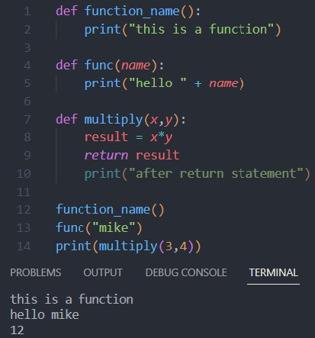
Making your own function
def function_name(args):
statement
-Number of arguments are unlimited
-statements after return don’t get executed
-call function after definition
-no return statement => Void function

Slide 57
Parameters VS Arguments
A parameter is the variable listed inside the parentheses in the function definition.
An argument is the value that is sent to the function when it is called.
-function must be called with the correct number of arguments

Slide 58
Docstrings (documentation strings)
-“””are similar to comments, in that they’re designed to explain code, But they’re more specific and have a different syntax”””
-Docstring of a function can be accessed by doc attribute.
-print(max.__doc__)

Slide 59
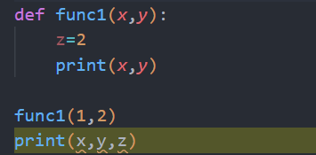

Function scope(Global vs local)
Global Variable
Local Variables & access
Global and Local variables with/without the same name
nonlocal variable

Slide 60



Global keyword
-When we create a variable inside a function, it is local by default.
-When we define a variable outside of a function, it is global by default. You don't have to use global keyword.
We use global keyword to read and write a global variable inside a function.
-Use of global keyword outside a function has no effect.

Slide 61

Nonlocal keyword
do not initialize a new variable, instead access VariableName presented already

Slide 62



Pass by value
An immutable variable cannot be changed once created
-create new instance and bind the variable to the new instance
Mutable variables can be changed in place
Immutable
mutable

Slide 63

recursion
Self-reference
A complicated function can be split down into smaller sub-problems utilizing recursion.
-include base case to stop the recursion

Slide 64

*args & **kwargs
Functions with varying numbers of arguments
(variable length argument)
-can't have more than 1 *args in the same function
-args is a convention you can use any name
-args is a tuple
-kwargs returns a dictionary

Slide 65

lambda function(anonymous function)
lambda arguments : expression
-can take any number of arguments, but can only have one expression.

Slide 66

Map and filter
They each take a function and a list of elements, and then return the result of applying the function to each element in the list

Slide 67

generators
easier way to create iterators
Improved performance, lower memory usage, don’t need to wait until all the elements have been generated before we start to use them.
A generator-function is defined like a normal function, but whenever it needs to generate a value, it does so with the yield keyword rather than return. If the body of a def contains yield, the function automatically becomes a generator function.

Slide 68


decorators
Modify functions using other functions
@decorator _name

Slide 69
List
Lists are used to store multiple items(can have different types) in a single variable.
List items are indexed(starting from 0), ordered, changeable, and can be duplicate values
myList1 = [1, 2, 3]
myList2 = [1.3, 4.5]
myList3 = [1, 2, 6.7]
myList4 = [“January”, “February”, “March”]
myList5 = [1, “January”, 2.3]

Slide 70
Create list
Li=[1,1,2.5,”python”]
Li1 = list() #empty list
Li2 = list([expretion])
List constructor:
thislist = list(("apple", "banana", "cherry")) # note the double round-brackets
*L = list(expression for variable in sequence)

Slide 71
Python creates a single new list every time we use []
>>> L1 = [1, 2, 3]
>>> L2 = [1, 2, 3]
>>> L1 == L2
True
>>> L1 is L2
False
>>>
>>> L3 = L4 = [1, 2, 3]
>>> L3 == L4
True
>>> L3 is L4
True
>>>
L1 and L2 have the same values but they are independent lists (i.e., they do not point to the same list)
L3 and L4 point to the same list

Slide 72

Access List Items
thislist = ["apple", "banana", "cherry"] print(thislist[1])

Slide 73


List operation
Output:

Slide 74


slicing
[start:end:step]
-including the start index but NOT including the end index
If step not specified step=1
If start / end not specified from the start / till the end.

Slide 75
List methods
append() | Adds an element at the end of the list
clear() | Removes all the elements from the list
copy() | Returns a copy of the list
count() | Returns the number of elements with the specified value
extend() | Add the elements of a list (or any iterable), to the end of the current list
index() | Returns the index of the first element with the specified value
insert() | Adds an element at the specified position
pop() | Removes the element at the specified position
remove() | Removes the first item with the specified value
reverse() | Reverses the order of the list
sort() | Sorts the list
List function
del(list[index]) | Deletes the content of the specified index of the list
len(list) | Returns the length of the list
max(list): | Returns the maximum value.
min(list): | Returns the minimum value.
sum(list) | Returns the sum of the list elements

Slide 76


Manipulating(copy a list)
Pass by value
Pass by reference
You cannot copy a list simply by typing list2 = list1, because: list2 will only be a reference to list1, and changes made in list1 will automatically also be made in list2.

Slide 77
List comprehension
List comprehension offers a shorter syntax when you want to create a new list based on the values of an existing list.
newlist = [expression for item in iterable if condition == True]
fruits = ["apple", "banana", "cherry", "kiwi", "mango"] newlist = [] for x in fruits: if "a" in x: newlist.append(x) print(newlist)
fruits = ["apple", "banana", "cherry", "kiwi", "mango"] newlist = [x for x in fruits if "a" in x] print(newlist)

Slide 78

Multi-Dimensional Lists
i is a list here!
ERROR: list indices must be integers or slices, not lists

Slide 79


Dictionary
Dictionaries are represented by Key:value pair and can be referred to by using the key name
Dictionaries are ordered, mutable(changeable), and do not allow duplicates.
-dictionaries are ordered, it means that the items have a defined order, and that order will not change.
-can be indexed but only through keys dict1[“NUM”] , dict1[1000]
-can use strings, integers, Booleans, and any other immutable type as dictionary keys.
-values can be of any data type
-can contain only unique keys but duplicate values
dict1 = {"NUM":45, 1000:"coding", 2000:4.5, 3.4:7, "XXX":89}
Duplicate key will overwrite existing values:

Slide 80
Dictionary methods
Method | Description
clear() | Removes all the elements from the dictionary
copy() | Returns a copy of the dictionary
get() | Returns the value of the specified key
items() | Returns a list containing a tuple for each key value pair
keys() | Returns a list containing the dictionary's keys
pop() | Removes the element with the specified key
popitem() | Removes the last inserted key-value pair
setdefault() | Returns the value of the specified key. If the key does not exist insert the key, with the specified value
update() | Updates the dictionary with the specified key-value pairs
values() | Returns a list of all the values in the dictionary

Slide 81

Accessing Dictionary Items
Accessing values: [key], .get(key) and .values()
Accessing keys:.keys() method
.values() .keys() .Items()
return a list view of dictionary(any changes will
be reflected in the list)

Slide 82

Check For Existing Key/Value
use in keyword to check for existing key
Or use setdefault(Key, DefaultValue)
-retunes value if key not found in the dictionary returns DefaultValue

Slide 83

Adding/Changing Dictionary Item
dictname[key] =value
Or with .update({key:value})
-you can both change and add
new items with these methods

Slide 84

Deleting Dictionary Item
.pop() removing the item with the specified key
.popitem() removing the last key:value pair
.clear() removing all elements
del keyword for deleting all or specified key item

Slide 85

Loop Through a Dictionary

Slide 86




mutable
Pass By Reference

Slide 87


operation
CANNOT be concatenated
CANNOT be repeated

Slide 88
Python Dictionary Comprehension
squares = {}
for x in range(6):
squares[x] = x*x
print(squares)
squares = {x: x*x for x in range(6)}
print(squares)

Slide 89

Dictionary Built-in Functions
Function | Description
all() | Return True if all keys of the dictionary are True (or if the dictionary is empty).
any() | Return True if any key of the dictionary is true. If the dictionary is empty, return False.
len() | Return the length (the number of items) in the dictionary.
sorted() | Return a new sorted list of keys in the dictionary.

Slide 90


nested
dic = {"first":{1:1}, "second":{2:"a"}}

Slide 91
When to use dictionary
When the data has a unique reference that can be associated with the value.
When quick access to data items is important. Dictionaries are designed to let us find a value instantly without the need for searching through the whole collection.
When the data order is not important.
As dictionaries are mutable, it is not a good idea to use dictionaries to store data that shouldn’t be modified in the first place.
When memory consideration is not an important factor for the application. Compared to lists and tuples, dictionaries take up more space in memory.

Slide 92

tuple
A tuple is a collection which is ordered, unchangeable(immutable), and allow duplicate values.
-have a defined order, and that order will not change.
-cannot change, add or remove items after the tuple has been created.
-can contain any and different types of elements even duplicate elements
tuple1 = ("apple", "banana", "cherry")
tuple2 = (1, 5, 7, 9, 3)
tuple3 = (True, False, False)
tuple1 = ("abc", 34, True, 40, “day")

Slide 93

operation
concatenation
repeat

Slide 94


immutable
Can't change/delete /add
item/value

Slide 95



IMMUTABEL
Pass by value

Slide 96
Tuple methods
Method | Description
count() | Returns the number of times a specified value occurs in a tuple
index() | Searches the tuple for a specified value and returns the position of where it was found
Function | Description
len() | Returns the length of the tuple
min() | Retunes the maximum value of tuple
max() | Retunes the minimum value of tuple
tuple() | Converts into a tuple.
del (keyword) | Deletes the entire tuple

Slide 97

Accessing tuple elements
1.Indexing TupleName[index]
-index starts from 0
-index are integers and must be less than tuple length
2.Iteration
-for loop
3.Slicing TupleName[start:end:step]

Slide 98

slice
TupleName[start:end:step]
-including the start index but NOT including the end index
If step not specified: step=1
If start/end not specified from the start/till the end.

Slide 99

packing
When we create a tuple, we normally assign values to it.
This is called "packing" a tuple:
we are also allowed to extract the values back into variables.
This is called "unpacking“:

Slide 100
When to use tuple over list
We generally use tuples for different data types and lists for similar data types.
Since tuples are immutable, iterating through a tuple is faster than with list. So there is a slight performance boost.
Tuples that contain immutable elements can be used as a key for a dictionary. With lists, this is not possible.
If you have data that doesn't change, implementing it as tuple will guarantee that it remains write-protected.

Slide 101


set
Sets are used to store collections of data in single variable.
A set is a collection which is unordered, unchangeable, and unindexed and doesn't allow duplicate values.
Set items are unchangeable, but you can remove items and add new items.
Sets are unordered, items can appear in a different order every time you use them and cannot be referred to by index or key.

Slide 102


Accessing items
You cannot access items in a set by referring to an index or a key.
loop through the set items using a for loop
check if a specified value is present in a set, by using the in keyword

Slide 103
Set methods
Method | Description
add() | Adds an element to the set
clear() | Removes all the elements from the set
copy() | Returns a copy of the set
difference() | Returns a set containing the difference between two or more sets
difference_update() | Removes the items in this set that are also included in another, specified set
discard() | Remove the specified item
intersection() | Returns a set, that is the intersection of two other sets
intersection_update() | Removes the items in this set that are not present in other, specified set(s)
isdisjoint() | Returns whether two sets have a intersection or not
issubset() | Returns whether another set contains this set or not
issuperset() | Returns whether this set contains another set or not
pop() | Removes an element from the set
remove() | Removes the specified element
symmetric_difference() | Returns a set with the symmetric differences of two sets
symmetric_difference_update() | inserts the symmetric differences from this set and another
union() | Return a set containing the union of sets
update() | Update the set with the union of this set and others

Slide 104

Adding items
Use .add() method to add an element
Use .update() method to add a collection of data
-can be list, dictionary, tuple, set.
Use .union() method to join two sets
-Both union and update will exclude any duplicate items.

Slide 105

Deleting elements
Use .remove() or .discard() method to delete an item
-remove() If item doesn't exist, will raise an error.
-discard() If item doesn't exist, won't raise an error.
.pop() method will remove the last item
-because sets are unordered,we don’t know what item will be removed.
.clear() removes all elements
del keyword delete the whole set

Slide 106
Functions to use of sets
Function | Description
all() | Returns True if all elements of the set are true (or if the set is empty).
any() | Returns True if any element of the set is true. If the set is empty, returns False.
enumerate() | Returns an enumerate object. It contains the index and value for all the items of the set as a pair.
len() | Returns the length (the number of items) in the set.
max() | Returns the largest item in the set.
min() | Returns the smallest item in the set.
sorted() | Returns a new sorted list from elements in the set(does not sort the set itself).
sum() | Returns the sum of all elements in the set.

Slide 107



Pass by reference
Copy value and reference
Right way of coping set value

Slide 108
frozenset
Frozenset is just an immutable version of a Python set object
Frozensets can be created using the frozenset() function.
-Supports copy(), difference(), intersection(), isdisjoint(), issubset(), issuperset(), symmetric_difference() and union() set methods.

Slide 109
Python Collections (Arrays)
There are four collection data types in the Python programming language:
List is a collection which is ordered and changeable. Allows duplicate members.
Tuple is a collection which is ordered and unchangeable. Allows duplicate members.
Set is a collection which is unordered, unchangeable*, and unindexed. No duplicate members.
Dictionary is a collection which is ordered** and changeable. No duplicate members.

Slide 110
Python Namespaces
A namespace is a collection of currently defined symbolic names along with information about the object that each name references. You can think of a namespace as a dictionary in which the keys are the object names, and the values are the objects themselves.
As Python executes a program, it creates namespaces as necessary and deletes them when they’re no longer needed. Typically, many namespaces will exist at any given time. These have differing lifetimes.
Name spaces types in python:
Built-In
Global
Enclosing
Local

Slide 111

Built-In
The built-in namespace contains the names of all of Python’s built-in objects. These are available at all times when Python is running.
-Use dir(__builtins__) to see list of all python built in name spaces

Slide 112
The Global Namespace
The global namespace contains any names defined at the level of the main program. Python creates the global namespace when the main program body starts, and it remains in existence until the interpreter terminates.
-The interpreter also creates a global namespace for any module that your program loads with the import statement.

Slide 113

The Local and Enclosing Namespaces
interpreter creates a new namespace whenever a function executes. That namespace is local to the function and remains in existence until the function terminates.
Functions don’t exist independently from one another only at the level of the main program.
-namespace created for g() is the local namespace,
-namespace created for f() is the enclosing namespace.

Slide 114
Each of these namespaces remains in existence until its respective function terminates. Python might not immediately reclaim the memory allocated for those namespaces when their functions terminate, but all references to the objects they contain cease to be valid.

Slide 115


Variable scope
Local: If you refer to x inside a function, then the interpreter first searches for it in the innermost scope that’s local to that function.
Enclosing: If x isn’t in the local scope but appears in a function that resides inside another function, then the interpreter searches in the enclosing function’s scope.
Global: If neither of the above searches is fruitful, then the interpreter looks in the global scope next.
Built-in: If it can’t find x anywhere else, then the interpreter tries the built-in scope.

Slide 116
Python Modules
a file containing Python statements and definitions (.py)
-modules can contain functions and also variables of all types (arrays, dictionaries, objects etc.)
-Python there also are built-in modules, such as sys, which are written in C
use modules to break down large programs into small manageable , organized and reusable files.(simplicity, Maintainability, Reusability, Scoping)
We can define our most used functions in a module and import it, instead of copying their definitions into different programs.
There are many modules available: NumPy, Matplotlib,..

Slide 117
Import
Use import keyword to use a module(library)
Access methods and attributes with .funcName() or .name
We can import specific names from a module without importing the whole module, with from moduleName import moduleFunc/moduleAtt
-In such cases, we don't use the dot operator
import all names/definitions from a module using: from moduleName import *
-use as to change module library: import moduleName as mN

Slide 118




Reloading a module
The Python interpreter imports a module only once during a session. This makes things more efficient.
Now if our module changed during the course of the program, we would have to reload it. One way to do this is to restart the interpreter(not recommended)
Instead use the reload() function inside the importlib(imp) module to reload a module. We can do it in the following ways:

Slide 119


dir() Built-in Function
We can use the dir() function to find out names that are defined inside a module.
-All other names that begin with an underscore are default Python attributes associated with the module (not user-defined).
-All the names defined in our current namespace can be found out using the dir() function without any arguments.

Slide 120

While importing a module, Python looks at several places. Interpreter first looks for a built-in module. Then(if built-in module not found), Python looks into a list of directories defined in sys.path. The search is in this order.
The current directory.
PYTHONPATH (an environment variable with a list of directories).
The installation-dependent default directory.

Slide 121

Python Package
A package is a folder with a bunch of modules
Packages provide hierarchical structuring of the module namespace using dot notation to be considered a package, that folder must contain an init.py file
-Thousands of packages available : pip, python-dateutil, Requests…
The package folder contains a special file called __init__.py

Slide 122
__init__.py
The Python interpreter recognizes a folder as the package if it contains __init__.py file.(essential)
__init__.py exposes specified resources from its modules to be imported.
An empty __init__.py file makes all functions from the above modules available when this package is imported.
-You can optionally define functions from individual modules to be made available.

Slide 123


Install a Package Globally
Once a package is created, it can be installed for system-wide use by running the setup script: from setuptools import setup
-each module is a script
Use pip install packageName command( to install package globally
Now myPackage is available for system-wide use and can be imported in any script or interpreter.

